Slide 1

25MCSIT303-Statistics and Data Analytics
Master of Science in CS and IT

Slide 2

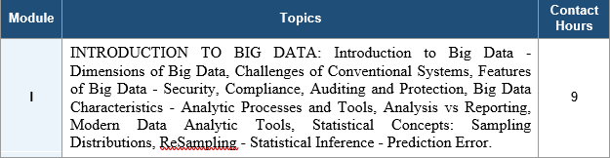
Module -1
Introduction to Big Data

Slide 3

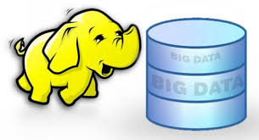



Slide 4
How much data ? How it matters?
Data Size matters……
How it matters……………….
Like this………..

Slide 5
bit (b) | 0 or 1 | 1/8 of a byte
byte (B) | 8 bits | 1 byte
kilobyte (KB) | 1000¹ bytes | 1,000 bytes
megabyte (MB) | 1000² bytes | 1,000,000 bytes
gigabyte (GB) | 1000³ bytes | 1,000,000,000 bytes
terabyte (TB) | 1000⁴ bytes | 1,000,000,000,000 bytes
petabyte (PB) | 1000⁵ bytes | 1,000,000,000,000,000 bytes
exabyte (EB) | 1000⁶ bytes | 1,000,000,000,000,000,000 bytes
zettabyte (ZB) | 1000⁷ bytes | 1,000,000,000,000,000,000,000 bytes
yottabyte (YB) | 1000⁸ bytes | 1,000,000,000,000,000,000,000,000 bytes

Slide 6
But Where and in which companies…….?
Every Where……. Like in……

Slide 7



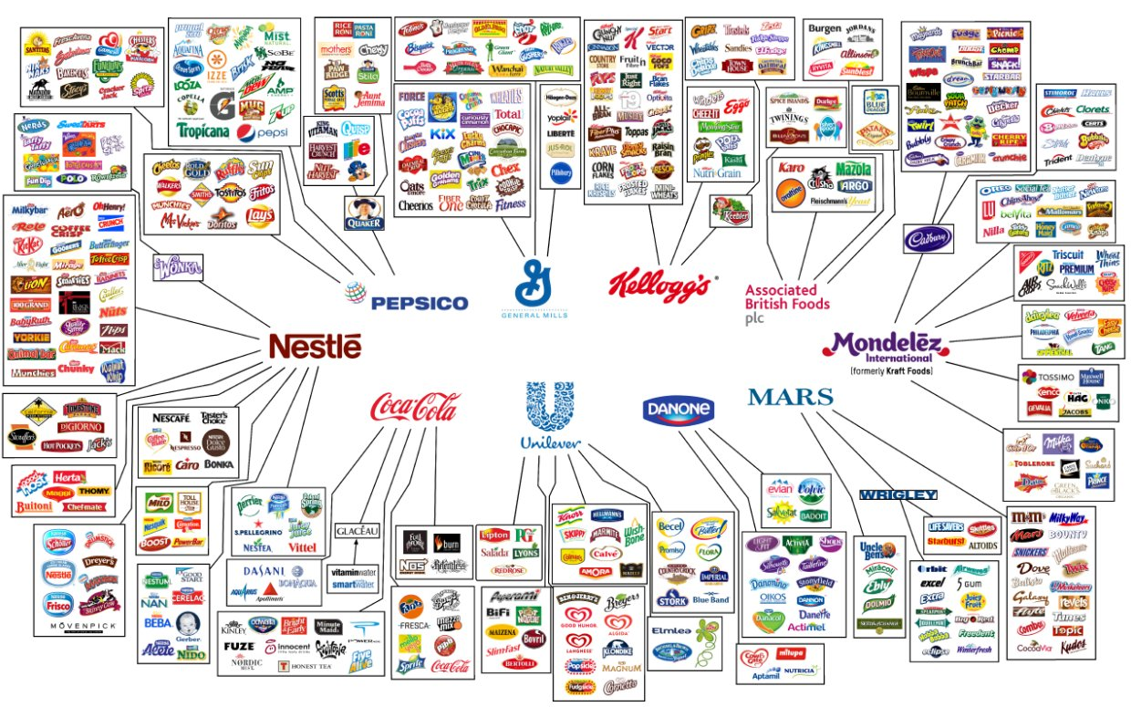

Slide 8
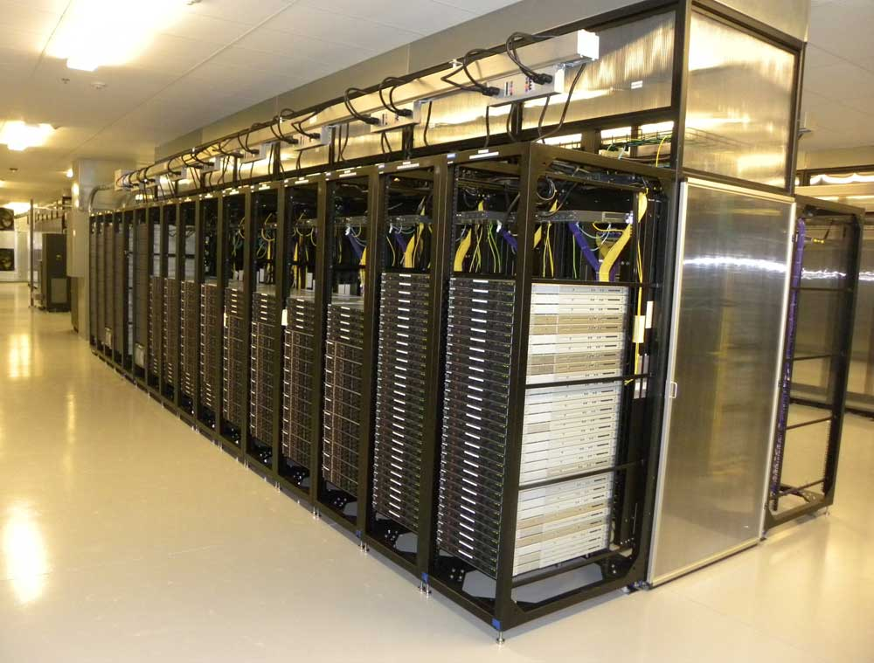
Where in real time…..?
Notes:
Yahoo Data center, New York.

Slide 9
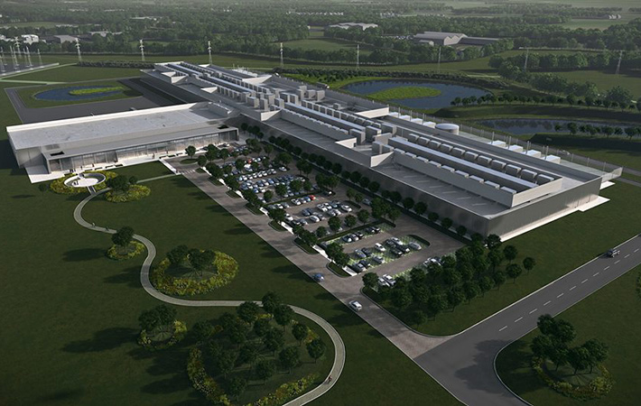
Where in real time…..?
Notes:
Facebook in Ireland

Slide 10
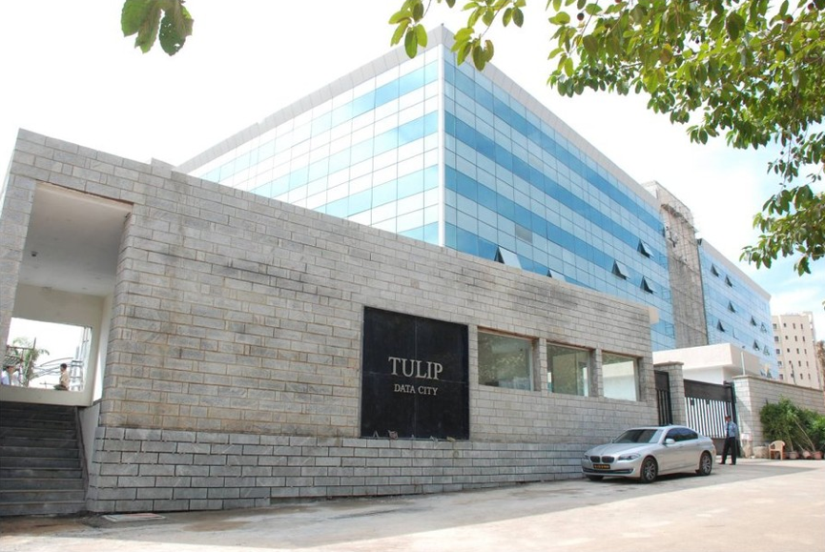
Where in real time…..?
Asia’s largest and world’s third largest data centre in Bengaluru
Notes:
Total Building SqFt: 900,000

Slide 11
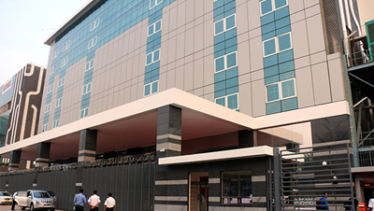
Where in real time…..?

Slide 12
Simple to start
What is the maximum file size you have dealt so far?
  Movies/Files/Streaming video that you have used?
  What have you observed?
What is the maximum download speed
you get?
Simple computation
  How much time to just transfer.

Slide 13

Careers in Analytics

Slide 14

Career Options in Analytics
No matter what your educational background or aspirations,
you have a fulfilling career in one of the many fields of Business Analytics.
FIELDS IN ANALYTICS
MIS
REPORTING
NON-PREDICTIVE ANALYTICS
PREDICTIVE ANALYTICS
MACHINE LEARNING
Data management
Data Exploration
MIS and report creation
Automation of reports
Segmentation
Customer profiling
Portfolio Analysis
Trend Analysis
Forecasting
Probability models
Classification and regression trees
Time series models
Neural networks
Multi-layer Perceptron
Geospatial models
Associative rule learning
Inductive logic programming
KEY FEATURES
BCom
B.E
BTech
BCom
B.E
BTech
MBAs
B.E
BTech
MSc (Statistics)
MBAs
MCA
MSc
B.E
BTech
MSc (Statistics)
MBAs
MCA
MSc
TARGET AUDIENCE
MIS Analyst
Data Analyst
Strategy Analyst
Cost Analyst
Data Scientist
Statistician
Advanced Analytics – Team Manager
Market / Global Research Analyst
Analytics Manager
INDICATIVE JOB ROLES

Slide 15
Career Path and Indicative Salaries (CTC)
CAREER TRAJECTORY
Skills require to succeed in the Industry
Strong analytical and critical thinking skills
Statistics
Predictive Analytics
SQL Knowledge
Understanding complex data & tools for Analytics
Soft Skills & Communication
Business Understanding
15+ Yrs
Director
10-15 Yrs
Average Salaries
VP
6-10 Yrs
AVP
Director
Rs. 15-20 Lakhs
4-6Yrs
AVP
Rs. 15-20 Lakhs
Manager
Manager
Rs. 9-15 Lakhs
2-4 Yrs
Senior Analyst
Senior Analyst
Rs. 6-8 Lakhs
0-2 Yrs
Analyst
Analyst
Rs 4-6 Lakhs

Slide 16














Careers
Top Companies Hiring for
Business Analytics
Rs. 15-20 Lakhs
Rs. 9-15 Lakhs

Slide 17
#What is Big Data?
What is Data?
The quantities, characters, or symbols on which operations are performed by a computer, which may be stored and transmitted in the form of electrical signals and recorded on magnetic, optical, or mechanical recording media.
Big Data is a term used for a collection of data sets that are large and complex, which is difficult to store and process using available database management tools or traditional data processing applications.

Slide 18
The challenge includes capturing, curating, storing, searching, sharing, transferring, analyzing and visualization of this data.
It is the capability to manage a huge volume of disparate data, at the right speed, and within the right time frame to allow real-time analysis and reaction.

Slide 19
Social Media & E-Commerce
Where user behavior generates data at massive scale
S
Social Media & Web
E
E-Commerce & Retail
Facebook / Instagram
Amazon Recommendations
Billions of photos, likes, and comments processed daily.
Purchase history & browsing behavior analyzed across hundreds of millions of users.
Twitter / X
Walmart Transactions
Millions of tweets streamed per minute for trend and sentiment analysis.
Over a million customer transactions per hour feed real-time inventory & pricing.
Google Search
Dynamic Pricing Engines
~8.5 billion searches per day, each logged with rich metadata.
Demand and competitor pricing data are blended for real-time price adjustments.
Big Data — Real-World Examples
3

Slide 20
Healthcare & Finance
High-stakes domains where speed and accuracy both matter
H
Healthcare
F
Finance
Hospital Record Systems
Fraud Detection
Aggregating patient records, imaging (MRI/CT), and genomic sequencing data.
Visa/Mastercard analyzing tens of thousands of transactions per second.
Wearable Devices
High-Frequency Trading
Continuous streams of heart rate, activity, and sleep data from millions of users.
Stock exchanges processing millions of trades per second, generating massive tick data.
Pandemic Tracking
Credit Risk Modeling
COVID-19 dashboards combining case counts, mobility, and genomic variant data in real time.
Combining transaction history, credit bureau, and behavioral data for risk scoring.
4

Slide 21
Transportation, IoT & Streaming Media
Continuous, real-time data powering everyday services
T
Transportation & IoT
S
Streaming & Entertainment
Uber / Ola
Netflix
Real-time GPS, traffic, and rider-demand data aggregated to power dynamic pricing.
Viewing patterns across 200M+ subscribers drive personalized recommendations.
Connected Cars
Spotify
Sensors generating continuous telemetry streams (speed, location, diagnostics).
Streaming logs analyzed to build playlists like Discover Weekly.
Smart City Sensors
YouTube
Traffic, air quality, and utility sensors feeding city-wide monitoring systems.
Billions of watch-hours logged daily to power content ranking & ads.
5

Slide 22
Government & Scientific Research
Large-scale public and research data infrastructure
1
CERN — Large Hadron Collider
2
Weather Forecasting
Generates approximately 1 petabyte of collision data per second; most is discarded in real time, with select data stored for deeper analysis.
National weather agencies ingest satellite imagery, global sensor networks, and decades of historical climate data to run prediction models.
3
Census & Public Records
4
Space & Earth Observation
Governments process demographic, economic, and administrative data across hundreds of millions of citizens.
Satellites continuously stream high-resolution imagery used for climate monitoring, agriculture, and disaster response.
Big Data — Real-World Examples
6

Slide 23
Examples Mapped to the V's
Example | Volume | Velocity | Variety | Veracity
CERN (LHC) | ✓ | ✓
Stock Exchanges / Fraud Detection |  | ✓
Social Media (Twitter/X, Facebook) | ✓ | ✓ |  | ✓
Healthcare Records & Imaging |  |  | ✓
Netflix / Spotify Recommendations | ✓ |  | ✓
Connected Cars / IoT Sensors |  | ✓ | ✓
7

Slide 24
# Importance of Big Data
Cost Optimization
  Reduces infrastructure and storage costs using distributed frameworks (Hadoop, Spark, Cloud).
  Improves resource utilization through scalable computing.
  Minimizes operational expenses using automation and predictive analytics.
    Example: Netflix uses cloud-based analytics to optimize storage and streaming costs.
2. Better and Faster Decision-Making
  Enables real-time data processing.
  Supports evidence-based business decisions.
  Provides dashboards and predictive insights.
    Example: Amazon recommends products instantly based on customer browsing history.

Slide 25
3. Customer Analytics
  Understands customer preferences and buying patterns.
  Improves customer satisfaction through personalized services.
  Enhances marketing effectiveness.
    Example: Spotify recommends songs based on listening behavior.
4. Innovation and New Product Development
  Identifies emerging market trends.
  Helps organizations develop customer-centric products.
  Accelerates product innovation using data-driven insights.
    Example: Tesla continuously improves vehicle performance using sensor data.

Slide 26
5. Fraud Detection and Risk Management
  Detects suspicious transactions in real time.
  Prevents financial fraud using machine learning models.
  Improves cybersecurity through anomaly detection.
    Example: Banks identify fraudulent credit card transactions within seconds.
6. Predictive Analytics
  Forecasts sales, demand, and customer behavior.
  Predicts equipment failures before they occur.
  Supports proactive business planning.
    Example: Airlines predict maintenance requirements to reduce downtime.

Slide 27
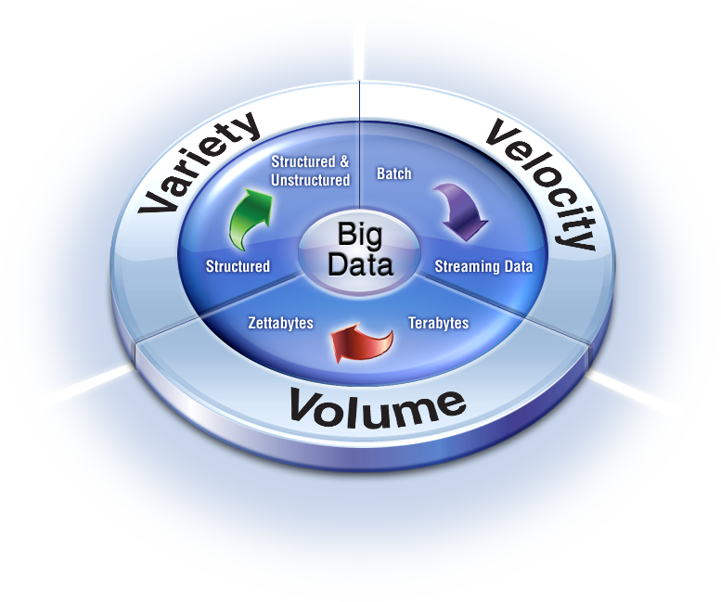
Dimensions of Big Data

Slide 28
Big data spans three dimensions: Volume, velocity and Variety
Volume: Volume refers to the ‘amount of data’, which is growing day by day at a very fast pace.
The size of data generated by humans, machines and their interactions on social media itself is massive.
Approximately 402.74 million terabytes of data are created each day (2026)
Around 181 zettabytes of data were generated in 2025
221 zettabytes of data are forecast to be generated in 2026
Example: Amazon continuously analyzes millions of customer clickstream events every day to power its product recommendations.

Slide 29
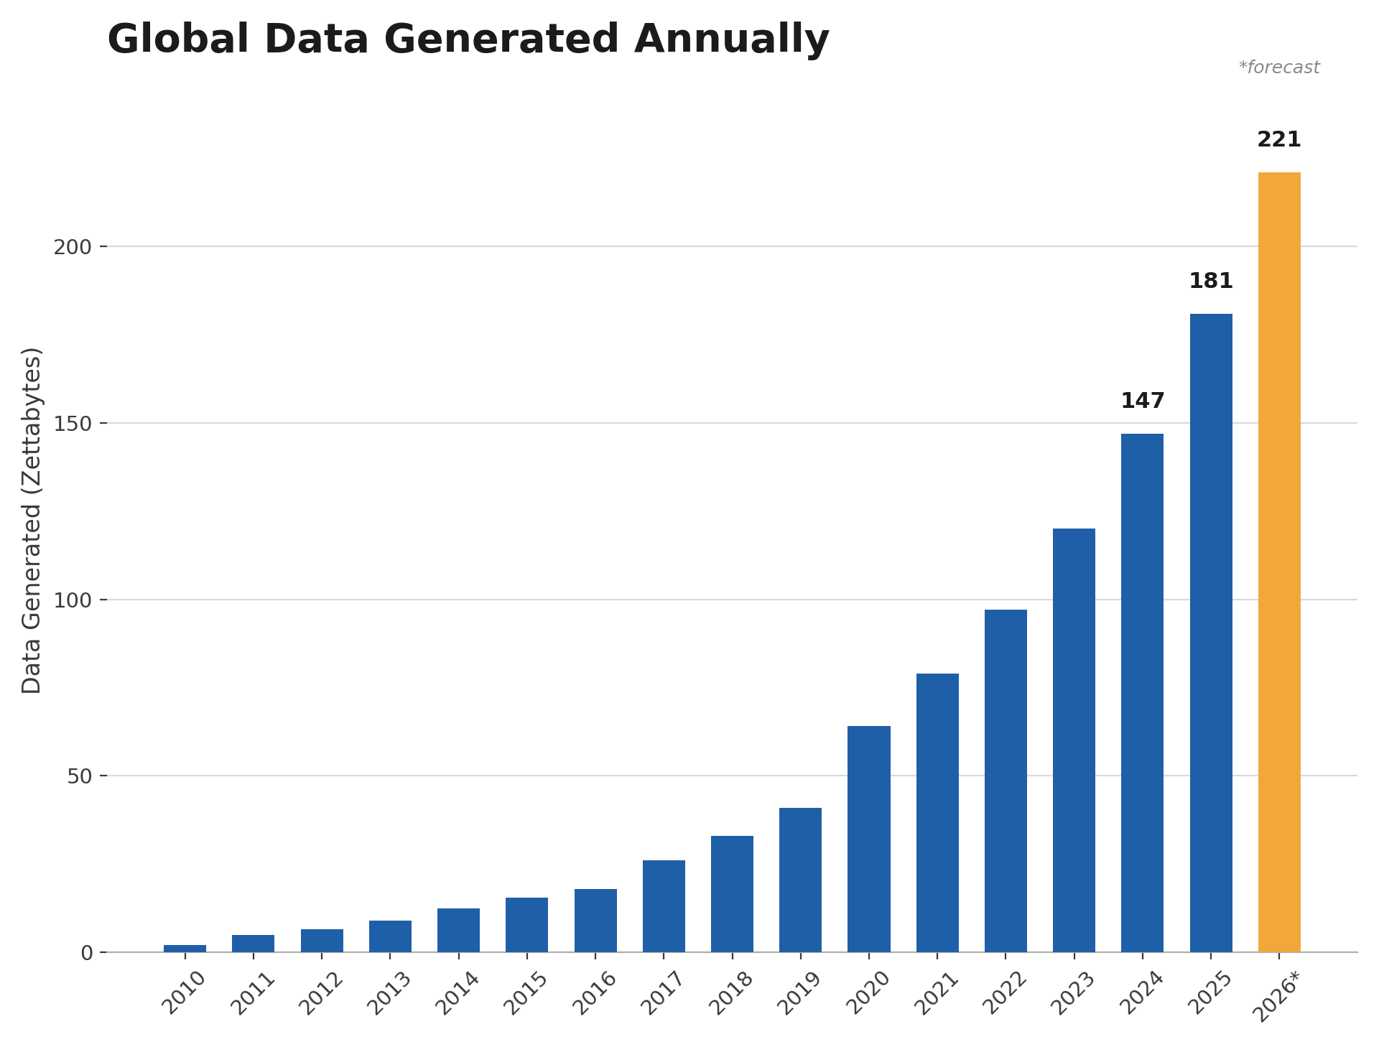

Slide 30

VELOCITY
Velocity is defined as the pace at which different sources generate the data every day.
This flow of data is massive and continuous. There are 2.11 billion Daily Active Users (Facebook DAU), up around 5.5% year-over-year.
This shows how fast the number of users are growing on social media and how fast the data is getting generated daily.
Late decisions → missing opportunities
Examples
  E-Promotions: Based on your current location, your purchase history, what you like → send promotions right now for store next to you
  500 hours of video are uploaded to YouTube every minute.

Slide 31
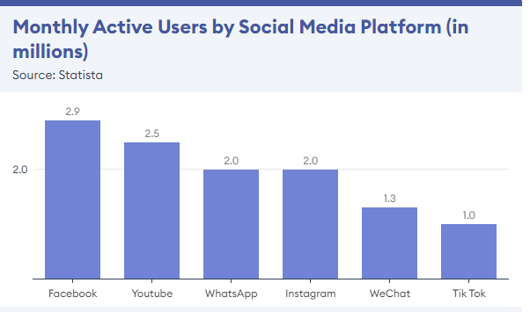

Slide 32
Case study(Discussion based)
Who use social media the most?
    Male or Female
    Reason

Slide 33
Variety – The next aspect of Big Data is its variety.
  Variety refers to heterogeneous sources and the nature of data, both structured and unstructured. During earlier days, spreadsheets and databases were the only sources of data considered by most of the applications.
  Nowadays, data in the form of emails, photos, videos, monitoring devices, PDFs, audio, etc. are also being considered in the analysis applications.
  This variety of unstructured data poses certain issues for storage, mining and analyzing data.

Slide 34
#Characteristics of Big Data
The eight (8) ‘V’ Dimension Characteristics of Big Data:
Part One: Volume, Velocity, Variety
Part Two: Variability (Unpredictability), Veracity (Reliability), Validity, Visualization and Value.

Slide 35
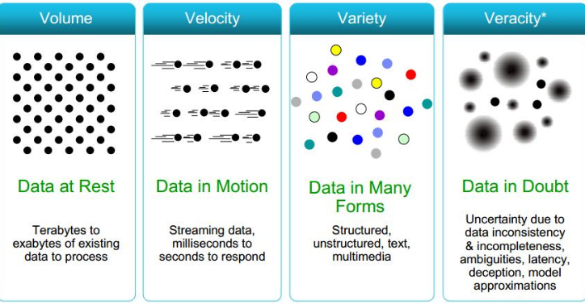

Slide 36
Variability refers to the inconsistency or fluctuation in data. It can occur in three ways:
  Changing meaning of data depending on the context.
  Fluctuating data volume due to events or trends.
  Different data formats coming from multiple sources.
Example 1: Changing Sentiment (Meaning)
  A company wants to analyze customer opinions about Imaginary Café from Twitter.
  Tweets:
  😊 Positive
  "Delicious muesli from @ImaginaryCafe – what a great way to start the day!"
  😐 Negative
  "Greatly disappointed that my local Imaginary Cafe has stopped stocking BLTs."
  😠 Negative (Sarcasm)
  "Had to wait in line for 45 minutes at the Imaginary Cafe today. Great, well there's my lunch break gone..."

Slide 37
Example 2: Fluctuating Data Volume
E-commerce Website
Normal Day | Festival Sale
5,000 orders/hour | 2,00,000 orders/hour
During Amazon Great Indian Festival, the amount of incoming data increases dramatically.
This variation in data flow is another example of Variability.
A hospital receives data from:
Electronic Health Records
X-ray Images
MRI Scans
Smart Watches
Lab Reports
Different formats and changing data patterns make processing more complex.

Slide 38
Veracity
Definition
  Quality, reliability, and accuracy of Big Data
  Ensures data is trustworthy and suitable for analysis
  Poor-quality data leads to incorrect decisions
Challenges
  Noisy and inconsistent data
  Missing values
  Duplicate records
  Biased or fake information
Restaurant Sales Example
  Verify source credibility
  Check completeness and duplicates
  Ensure data is current and unbiased

Slide 39
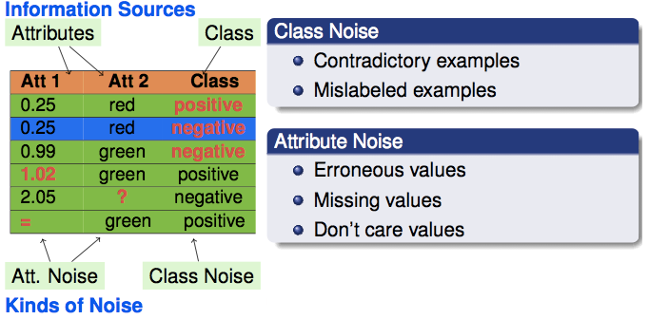
Noisy data
Improving Veracity
  Data Cleaning
  Data Validation
  Outlier Detection
  Data Governance

Slide 40
Validity
Similar to veracity, validity refers to how accurate and correct the data is for its intended use.
It ensures that the data collected is appropriate for answering the research or business problem.
According to Forbes, an estimated 60 percent of a data scientist's time is spent cleansing their data before being able to do any analysis.
Why is Validity Important?
  Ensures reliable and meaningful analysis.
  Improves the quality of decision-making.
  Reduces errors caused by incorrect or irrelevant data.
  Supports trustworthy machine learning and AI models.

Slide 41
Volatility
  Big data volatility refers to how long is data valid and how long should it be stored.
  In this world of real time data you need to determine at what point is data no longer relevant to the current analysis.
Visualization :
  Visualization is the graphical representation of data using charts, graphs, dashboards, and maps.
  It transforms large and complex datasets into easy-to-understand visual insights.

Slide 42
Value : Value is the end game. After addressing volume, velocity, variety, variability, veracity, and visualization – which takes a lot of time, effort and resources – you want to be sure your organization is getting value from the data.
Value refers to the business benefits and actionable insights derived from Big Data.
It is the ultimate goal of Big Data analytics—transforming raw data into measurable outcomes.

Slide 43
Challenges of Conventional Systems
Traditional database systems (RDBMS) are designed for structured and moderate-sized data. With the exponential growth of Big Data, they face several limitations.
  1. Limited Storage Capacity
  Cannot efficiently store petabytes or exabytes of data.
  Scaling requires expensive hardware upgrades (Vertical Scaling).
  2. Poor Processing Speed
  Sequential processing increases execution time.
  Unable to process real-time streaming data efficiently.

Slide 44
  3. Handling Variety
  Designed mainly for structured data.
  Struggles with semi-structured (JSON, XML) and unstructured data (images, videos, social media).
4. Limited Fault Tolerance
System failure can result in data loss.
No automatic replication or distributed recovery mechanisms.
5. Limited Real-Time Analytics :
Traditional systems are optimized for transactional processing.
Not suitable for real-time analytics and machine learning workloads.

Slide 45
Other Challenges of Conventional Systems
Data challenges
Volume, velocity, veracity, variety
Data discovery and comprehensiveness
Capturing Data
Aligning data from different sources
Transforming data into suitable form for data analysis
Modeling data (Mathematically, simulation)
Understanding output, visualizing results and display issues on mobile devices.

Slide 46
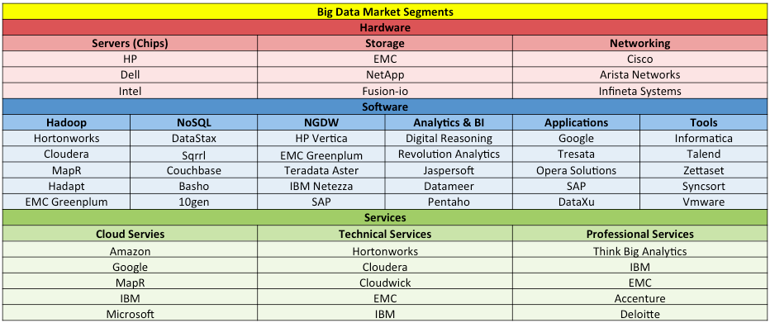
Analytic Processes and Tools

Slide 47
1. Apache Hadoop
Apache Hadoop is a java based free software framework that can effectively store large amount of data in a cluster. This framework runs in parallel on a cluster and has an ability to allow us to process data across all nodes. Hadoop Distributed File System (HDFS) is the storage system of Hadoop which splits big data and distribute across many nodes in a cluster. This also replicates data in a cluster thus providing high availability.
2. Microsoft HDInsight
It is a Big Data solution from Microsoft powered by Apache Hadoop which is available as a service in the cloud. HDInsight uses Windows Azure Blob storage as the default file system. This also provides high availability with low cost.
3. NoSQL
While the traditional SQL can be effectively used to handle large amount of structured data, we need NoSQL (Not Only SQL) to handle unstructured data. NoSQL databases store unstructured data with no particular schema. Each row can have its own set of column values. NoSQL gives better performance in storing massive amount of data. There are many open-source NoSQL DBs available to analyze big Data.

Slide 48
4. Hive : Apache Hive is an open source data warehouse system built on top of Hadoop Housed for querying and analyzing large datasets stored in Hadoop files. It process structured and semi-structured data in Hadoop.
5. Sqoop : This is a tool that connects Hadoop with various relational databases to transfer data. This can be effectively used to transfer structured data to Hadoop or Hive.
6. Presto : Facebook has developed and recently open-sourced its Query engine (SQL-on-Hadoop) named Presto which is built to handle petabytes of data. Unlike Hive, Presto does not depend on MapReduce technique and can quickly retrieve data.
7. Map Reduce: Map Reduce is a programming model and software framework first established by Google. It works similar to a UNIX pipeline. A Map Reduce job splits the input dataset into independent subsets that are managed by map tasks in parallel. This step of mapping is then followed by a step of reducing tasks. These reduce tasks use the output of the maps to obtain the final result.

Slide 49
Features of Big Data - Security, Compliance, Auditing and Protection
The sheer size of a Big Data repository brings with it a major security challenge, generating the age-old question presented to IT: How can the data be protected?
    Steps to Secure Big Data
    Classifying Data
    Protecting Big Data
    Big Data and Compliance
    The Intellectual Property Challenge

Slide 50
Security, Compliance, Auditing and Protection
Data Access:
Data can be easily protected, but only if you eliminate access to the data. That’s not a pragmatic solution, to say the least. The key is to control access, but even then, knowing the who, what, when, and where of data access is only a start.
Data availability:
Controlling where the data are stored and how the data are distributed. The more control you have, the better you are positioned to protect the data.

Slide 51
Performance:
Higher levels of encryption, complex security methodologies, and additional security layers can all improve security. However, these security techniques all carry a processing burden that can severely affect performance.
Liability:
Accessible data carry with them liability, such as the sensitivity of the data, the legal requirements connected to the data, privacy issues, and intellectual property concerns.

Slide 52
PRAGMATIC STEPS TO SECURE BIG DATA
First, get rid of data that are no longer needed. If you do not need certain information, it should be destroyed, because it represents a risk to the organization.
Information cannot legally be destroyed; in that case, the information should be securely archived by an offline method.
Real challenge is to decide which data is needed? As values can be found in unexpected places. For example, getting rid of activity logs may be a smart move from a security standpoint.

Slide 53
Classifying data
Protecting data becomes much easier if the data are classified—that is, the data should be divided into appropriate groupings for management purposes.
    For example, Internal e-mails between two colleagues should not be secured or treated the same way as financial reports, human resources (HR)information, or customer data.
Classification can become a powerful tool for determining the sensitivity of data.
    A simple approach may just include classifications such as financial, HR, sales, inventory, and communications, each of which is self-explanatory and offers insight into the sensitivity of the data.
Once organizations better understand their data, they can take important steps to segregate the information, which will make the deployment of security measures like encryption and monitoring more manageable.

Slide 54
PROTECTING BIG DATA ANALYTICS
Big Data contains large amounts of valuable and sensitive information, making it difficult to protect.
It includes unique, real-time data collected from sensors and IoT devices, such as:
  Traffic and vehicle movement
  Soil pH levels
  Rainfall and weather conditions
  Wind speed and direction
Since this data is generated continuously in real time, each data point is unique.
If the data is lost or corrupted, it cannot be recreated, unlike traditional data.
Because the data is unique, backup optimization techniques such as data deduplication (removing duplicate copies) are less effective.
As a result, Big Data requires strong security, reliable backup, and efficient disaster recovery strategies.

Slide 55
This greatly increases the capacity requirements for backup subsystems, slows down security scanning, makes it harder to detect data corruption, and complicates archiving.
There is also the issue of the large size and number of files often found in Big Data analytic environments.
In order for a backup application and associated appliances or hardware to churn through a large number of files, bandwidth to the backup systems and/or the backup appliance must be large, and the receiving devices must be able to ingest data at the rate that the data can be delivered.

Slide 56
BIG DATA AND COMPLIANCE
Compliance has a major effect on how Big Data is protected, stored, accessed, and archived.
Big Data is not easily handled by the RDBMS; This means it is harder to understand how compliance affects the data.
Big Data is transforming the storage and access paradigms to an emerging new world of horizontally scaling, unstructured databases, which are better at solving some old business problems through analytics.
New data types and methodologies are still expected to meet the legislative requirements expected by compliance laws.

Slide 57
Health care probably provides the best example for those charged with compliance as they examine how Big Data creation, storage, and flow work in their organizations.
Electronic health record systems, driven by the Health Insurance Portability and Accountability Act (HIPAA).-Storing Personal information.
Unfortunately, most of the data stores in use today—including Hadoop, Cassandra, and MongoDB—do not incorporate sufficient data security tools to provide enterprises with the peace of mind that confidential data will remain safe and secure at all times.

Slide 58
THE INTELLECTUAL PROPERTY CHALLENGE
One of the biggest issues around Big Data is the concept of intellectual property (IP).
IP refers to creations of the human mind, such as inventions, literary and artistic works, and symbols, names, images, and designs used in commerce.
Between 1985 and 2010, the number of patents granted worldwide rose from slightly less than 400,000 to more than 900,000. Increase of more than 125 percent over one generation (25 years).
The same concepts just have to be expanded into the realm of Big Data. Some basic rules are as follows:

Slide 59
Understand what IP is and know what you have to protect:
    What needs to protect it, how to protect it and whom to protect it from.TO do so, IP security in IT (usually a computer security officer, or CSO) must communicate on an ongoing basis with the executives who oversee intellectual capital. Meeting at least quarterly. Corporate leaders will be the foundation for protecting IP.
Prioritize protection:
    CSOs with extensive experience normally recommend doing a risk and cost-benefit analysis.
    require you to create a map of your company’s assets and determine what information, if lost, would hurt your company the most.
    This help you figure out where to best allocate your protective efforts.

Slide 60
Label:
    Confidential information should be labeled appropriately. If company data are proprietary, note that on every log-in screen.
Lock it up:
    Physical as well as digital protection schemes are a must. Rooms that store sensitive data should be locked. This applies to everything from the server farm to the file room. Keep track of who has the keys, always use complex passwords, and limit employee access to important databases.
Educate employees.
Know your tools:
    Those tools can locate sensitive documents and keep track of how they are being used and by whom.
Use a counterintelligence mind-set:
    If you were spying on your own company, how would you do it?

Slide 61
These guidelines can be applied to almost any information security paradigm that is geared toward protecting IP.
The same guidelines can be used when designing IP protection for a Big Data platform.

Slide 62
#Analysis vs Reporting
While Reporting provides data, Analytics is supposed to provide answers.
Reporting is typical Standardized while Analytics is customized.
Reporting has a stringent format while Analytics is flexible.
Reporting provides what is typically asked for, while Analytics caters to the underlying need.

Slide 63
The output of Reporting is in the form of canned reports, dashboards and alerts while Analytics has presentations comprising of insights, recommended actions, and a forecast of its impact on the company.
Reporting includes building, configuring, consolidating, organizing, formatting, and summarizing data while Analytics consist of questioning, examining, interpreting, predicting and prescribing.

Slide 64
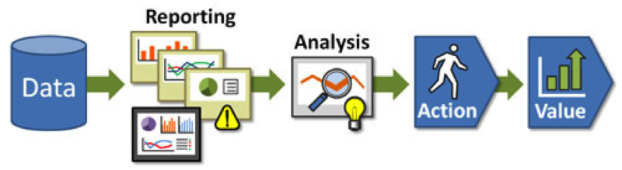
Both reporting and analysis play their roles in influencing and driving the actions in an organization with the ultimate goal of value maximization.

Slide 65
Canned reports:
Canned reports are typically distributed across a wide audience with polished formatting. These reports are short and sweet, batched and scripted data for weekly or monthly metrics.
For example, a good candidate for a canned report would be a monthly reporting package produced for a CFO and finance managers that displays data on how the company is measured (e.g. balance sheet, P&L, operational metrics, cash flow).

Slide 66
Real-World Example
Canned Report (Hospital)
Every morning, the hospital management receives a report showing:
Number of patients admitted
Number of discharges
ICU occupancy
Available beds
This report is generated automatically every day.

Slide 67
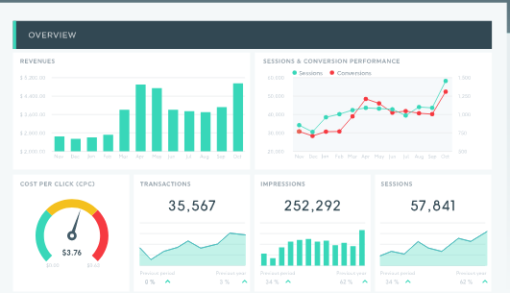
Dashboards:
These custom-made reports combine different KPIs and reports to provide a comprehensive, high-level view of business performance for specific audiences. Dashboards may include data from various data sources and are also usually fairly static.

Slide 68
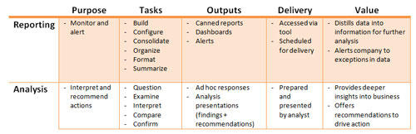
Alerts:
These conditional reports are triggered when data falls outside of expected ranges or some other pre-defined criteria is met. Once people are notified of what happened, they can take appropriate action as necessary.

Slide 69
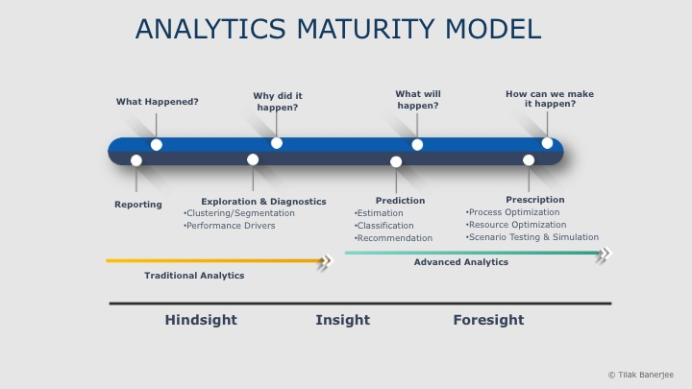
To overcome the first huddle of the initial confusion between Reporting and Analytics and taken a leap towards deriving the real benefits of analysis.

Slide 70
Statistics
Statistics is the science of collecting, analysing, and interpreting data to uncover patterns and make decisions. In data science, it acts as the backbone for understanding data and building reliable models.
Summarizes data using measures like mean, median, and variance
Models uncertainty with probability and distributions
Tests hypotheses
Finds relationships through regression and correlation

Slide 71
Types of Statistics
There are commonly two types of statistics, which are discussed below:
Descriptive Statistics: It helps us simplify and organize big chunks of data. This makes large amounts of data easier to understand.
Inferential Statistics: Inferential Statistics is a little different. It uses smaller data to conclude a larger group. It helps us predict and draw conclusions about a population.

Slide 72
Ex: 1. College Student Performance
Descriptive Statistics
Suppose 200 MSc students appeared for a Data Analytics exam.
Marks:
Average (Mean) = 72
Highest = 98
Lowest = 35
Pass Percentage = 92%
Interpretation:
These statistics simply describe the performance of those 200 students.

Slide 73
Inferential Statistics
Instead of analyzing all 200 students, you randomly select 40 students.
From these 40 students:
Average marks = 74
Using inferential statistics, you conclude:
"The average marks of all 200 MSc students are likely to be around 74, with a small margin of error."
Here, you're using a sample to estimate the entire population.

Slide 74
Statistical Concepts: Sampling Distributions
Sample: A sample is a subset of the population chosen to represent the whole population.
Researchers use samples because studying the entire population is often time-consuming, expensive, or impractical.
A sampling distribution is the distribution of a statistic (such as the sample mean or sample proportion) obtained by taking many random samples of the same size from a population.
Why do we need Sampling Distribution?
Suppose a university has 10,000 students.
Finding the average height of every student is expensive and time-consuming.

Slide 75
Real-Time Example: Online Shopping (Amazon/Flipkart)
Suppose Amazon wants to know the average delivery time.
Population: 1,00,000 deliveries
Instead of checking all deliveries, they randomly select different samples.
Sample | Number of Deliveries | Average Delivery Time
1 | 500 | 2.8 days
2 | 500 | 3.1 days
3 | 500 | 2.9 days
4 | 500 | 3.0 days
5 | 500 | 2.7 days

Slide 76
The averages
2.8, 3.1, 2.9, 3.0, 2.7
make up the sampling distribution of the sample mean.
Amazon can confidently estimate:
"The average delivery time is about 3 days."
without checking every order.

Slide 77
#Re-Sampling
Imbalanced Class Distribution, which generally happens when observations in one of the classes are much higher or lower than in other classes.
Resampling Method is a statical method that is used to generate new data points in the dataset by randomly picking data points from the existing dataset.
Resampling is a statistical technique in which multiple samples are repeatedly drawn from an existing dataset to estimate the accuracy, reliability, or variability of a statistical model.
It helps in creating new synthetic datasets for training machine learning models and to estimate the properties of a dataset when the dataset is unknown, difficult to estimate, or when the sample size of the dataset is small.

Slide 78
Two common methods of Resampling are
Cross Validation
Bootstrapping
Cross Validation
Cross-Validation is used to estimate the test error associated with a model to evaluate its performance.
Validation set approach:
This is the most basic approach. It simply involves randomly dividing the dataset into two parts: first a training set and second a validation set or hold-out set. The model is fit on the training set and the fitted model is used to make predictions on the validation set.

Slide 79
Contn..
Bootstrapping
Bootstrapping is the process of creating many new samples from an existing sample by selecting observations with replacement.
"With replacement" means that after an item is selected, it is put back into the dataset before the next selection. Therefore, the same item can be selected multiple times.
Bootstrap is a powerful statistical tool used to quantify the uncertainty of a given model.

Slide 80
Real-Time Example 1: Student Marks (Bootstrap)
Suppose a teacher has marks of 10 students:
Student | Marks
A | 65
B | 70
C | 72
D | 75
E | 80
F | 82
G | 85
H | 88
I | 90
J | 95

Slide 81
Instead of collecting marks from another class, the teacher creates many new samples from these same 10 students.
Bootstrap Samples (Sampling with Replacement)
Sample 1
  65, 70, 70, 82, 88, 90, 95, 75, 65, 80
Sample 2
  72, 72, 82, 95, 95, 88, 80, 65, 90, 75
Here,
Some students appear more than once (e.g., 95 appears twice).
Some students may not appear at all.
The teacher calculates the average for each sample and estimates the variability of the class average.

Slide 82
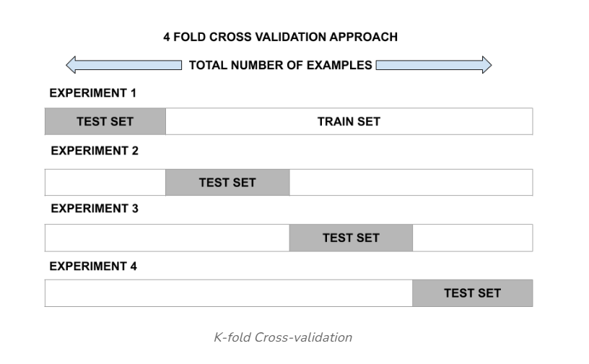
k-fold cross-validation
This approach involves randomly dividing the set of observations into k folds of nearly equal size.
The first fold is treated as a validation set and the model is fit on the remaining folds.
The procedure is then repeated k times, where a different group each time is treated as the validation set.

Slide 83
Real-Time Example : Machine Learning (Cross-Validation)
A bank wants to build a model to predict loan defaults.
Dataset:
5,000 customer records
Instead of splitting the data only once, the bank uses 5-Fold Cross-Validation.
Step 1
Divide the dataset into 5 equal parts.
  Fold 1
  Fold 2
  Fold 3
  Fold 4
  Fold 5

Slide 84
Step 2
Train and test repeatedly.
Round | Training Data | Testing Data
1 | Fold 2–5 | Fold 1
2 | Fold 1,3,4,5 | Fold 2
3 | Fold 1,2,4,5 | Fold 3
4 | Fold 1,2,3,5 | Fold 4
5 | Fold 1,2,3,4 | Fold 5
The final accuracy is the average of the five test results.
This is a resampling technique because the same dataset is reused multiple times.

Slide 85
Statistical Inference
Statistical Inference, Model & Estimation
Statistical inference is the process of using information from a sample to make conclusions or predictions about a larger population.
A statistical model is a representation of a complex phenomena that generated the data.
It has mathematical formulations that describe relationships between random variables and parameters.
It makes assumptions about the random variables, and sometimes parameters.
A general form: data = model + residuals
The model represents the systematic pattern in the data, while the residual represents the difference between what we actually observe and what the model predicts.

Slide 86
Main Types of Statistical Inference
A. Estimation
We use sample data to estimate an unknown population parameter.
For example:
A company wants to know the average monthly electricity bill of its customers.
It selects 100 customers and finds:
Sample mean = ₹2,450
The company may estimate that:
"The average electricity bill for all customers is approximately ₹2,450 per month."

Slide 87
There are two common types:
Point estimation:
A single value is used as the estimate.
Estimated average = ₹2,450
Interval estimation:
A range of values is provided.
Average bill is estimated to be between ₹2,300 and ₹2,600.
This range is called a confidence interval.

Slide 88
B. Hypothesis Testing
Hypothesis testing helps us determine whether there is enough statistical evidence to support a claim.
Real-time example: New teaching method
  Suppose a teacher introduces a new teaching method.
  Before the method:
  Average student score = 65
  After introducing the method, 50 students are tested.
  Sample average = 72
  Qn: Did the new teaching method actually improve the scores, or could the difference have occurred by chance?

Slide 89
Null hypothesis (H₀): The new teaching method does not improve scores.
Alternative hypothesis (H₁): The new teaching method improves scores.
A statistical test gives a p-value.
If:
p-value < 0.05
we generally reject H₀ and conclude that there is statistically significant evidence that the teaching method improved scores.

Slide 90
Prediction Error
A prediction error is the failure of some expected event to occur.
When predictions fail, humans can use metacognitive functions, examining prior predictions and failures and deciding, for example, whether there are correlations and trends, such as consistently being unable to foresee outcomes accurately in particular situations.
Applying that type of knowledge can inform decisions and improve the quality of future predictions.

Slide 91
Predictive analytics software processes new and historical data to forecast activity, behavior and trends.
The programs apply statistical analysis techniques, analytical queries and machine learning algorithms to data sets to create predictive models that quantify the likelihood of a particular event happening.
Errors are an inescapable element of predictive analytics that should also be quantified and presented along with any model, often in the form of a confidence interval that indicates how accurate its predictions are expected to be.
Analysis of prediction errors from similar or previous models can help determine confidence intervals.

